Slide 1
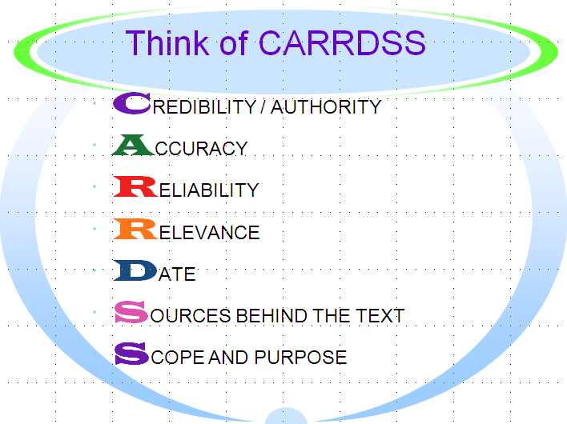
CARRDSS System Joyce Valenza, 2008
7 Criteria for Web Evaluation SECONDARY (ADVANCED)
Recently, Joyce Valenza took web evaluation to another level, with the CARRDS system.

Slide 2
7 Criteria for Web Evaluation SECONDARY (ADVANCED)

Slide 3
What does it mean?
Credibility | Is this a credible source?
Accuracy | Are the facts and information found here accurate?
Reliability | Can you rely on the information? Is it valid?
Relevance | How important is this information? Is it related to what you are looking for?
Date | What is the date of the source? How old is it? Is the information still current?
Sources behind the text | Who is the author? Do they have a bias or intended message of political, religious, or personal views?
Scope and Purpose | How well known is the site? Why do they have the site?

Slide 4
Assignment
1. Select 2 web sites and critically evaluate using the CARRDSS system. 2. List the title and web site; key your comments in the colored boxes. 3. Submit digitally / include in your portfolio.

Slide 5
Web address: Title of Site:
Credibility
Accuracy
Reliability
Relevance
Date
Sources behind the text
Scope and Purpose

Slide 6
Web address: Title of Site:
Credibility
Accuracy
Reliability
Relevance
Date
Sources behind the text
Scope and Purpose

Slide 7
Web address: Title of Site:
Credibility
Accuracy
Reliability
Relevance
Date
Sources behind the text
Scope and Purpose

Slide 8
Web address: Title of Site:
Credibility
Accuracy
Reliability
Relevance
Date
Sources behind the text
Scope and Purpose

